Slide 1

Introduction to Spark
Ángel J. Rey

Slide 2
AGENDA
Scope of the course
Spark core concepts
RDDs and Partitioning
Spark Architecture
Spark SQL and DataFrames
Spark Streaming

Slide 3
Introduction to spark
1. Scope of the course

Slide 4
Scope of the course
introduction to spark
Introduction to Spark with:
Lectures
Hands-on exercises
Virtual Machine
And much more …
Course Materials available in GitHub
https://github.com/chicochica10/spark-scala-developer
Contact me if you need help !!

Slide 5
Introduction to spark
2. Spark core concepts

Slide 6
2. Spark Core Concepts
introduction to spark
What is Apache Spark
Basic Concepts
The Spark Shell

Slide 7
Exercise 0
introduction to spark
Prepare the Environment

Slide 8
What is Apache Spark
introduction to spark
Apache Spark is a distributed computing platform designed to be fast and general purpose
Spark extends the map-reduce model to efficiently support more types of in-memory computations, including interactive queries and stream processing

Slide 9
What is Apache Spark
introduction to spark
From the general purpose Spark is designed to cover a wide range of workloads that previously required separate distributed systems:
batch applications
iterative algorithms
streaming

Slide 10
What is Apache Spark
introduction to spark
Spark is designed to be highly accessible, offering simple APIs
Python, Java, Scala, R, SQL
Spark can run in Hadoop clusters and access any Hadoop data source

Slide 11
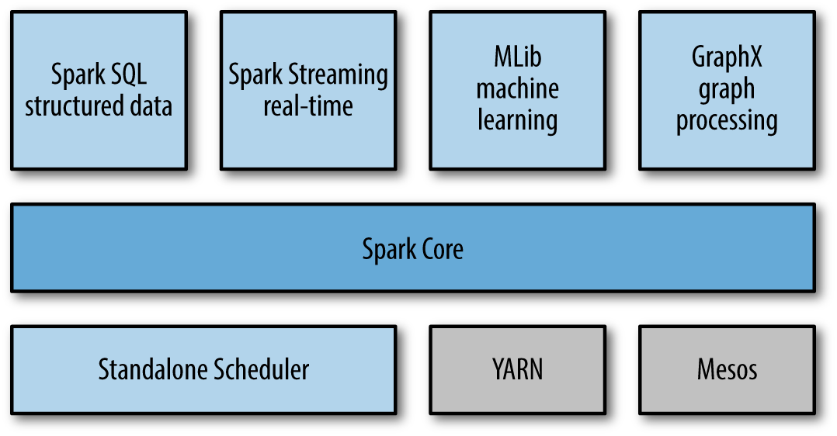
Unified Stack
introduction to spark
Core:
scheduling, distributing and monitoring computational tasks across nodes
High-level components:
specialized for various applications
SQL: allows querying data via SQL, Hive and Data Frames
Stream processing: processing of data live streams (events, logs, …)
Machine Learning, graphs: for parallel computation of machine learning algorithms: classification, regression, clustering, etc…

Slide 12
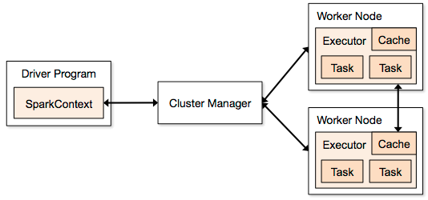
Spark cluster infraestructure
introduction to spark
Spark is an Open-source cluster computing framework
Requires cluster manager
Standalone – simple cluster manager included in Spark
Apache Mesos – general, large scale cluster manager
Hadoop YARN – resource manager for Hadoop
Distributed storage system
HDFS (Hadoop Distributed File System
Amazon S3
Cassandra, OpenStack Swift, Tachyon
Also supports pseudo-distributed mode
Development and testing
local file system, one worker per CPU core

Slide 13

Brief History
introduction to spark
2009 - Initially started at UC Berkeley AMPLab
https://amplab.cs.berkeley.edu/
2010 - Open sourced under a BSD license
2013 - Donated to the Apache Software Foundation
Apache 2.0 license
Feb 2014 - Became an Apache Top-Level Project
Nov 2014 - Databricks set a new world record in large scale sorting using Spark
100TB (1 trillion records) sorted in 23 minutes, 206 EC2 machines
Previously: Hadoop MapReduce, 72 minutes, 2100 machines
3X faster, 10X fewer machines
Sorting on HDFS (disk), not using in-memory cache!

Slide 14
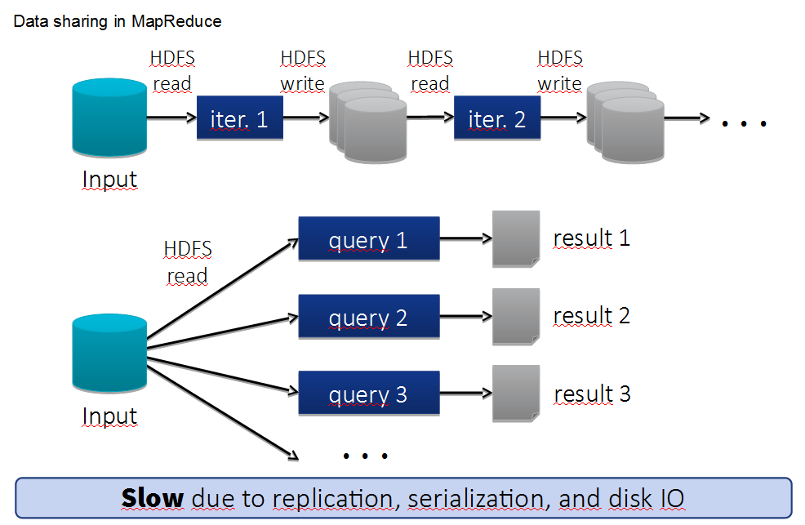
Problems with Hadoop Map-Reduce
introduction to spark
Batch oriented
So, Hive, Pig and all MR-based systems too
Great throughput but high latency
Not for BI tools
Not for real-time (stream) processing
Programming model not good for iterative programming (e.g. machine learning)
Forces to concatenate multiple jobs
External orchestration
Each job flushes to disk
Data sharing requires external storage

Slide 15
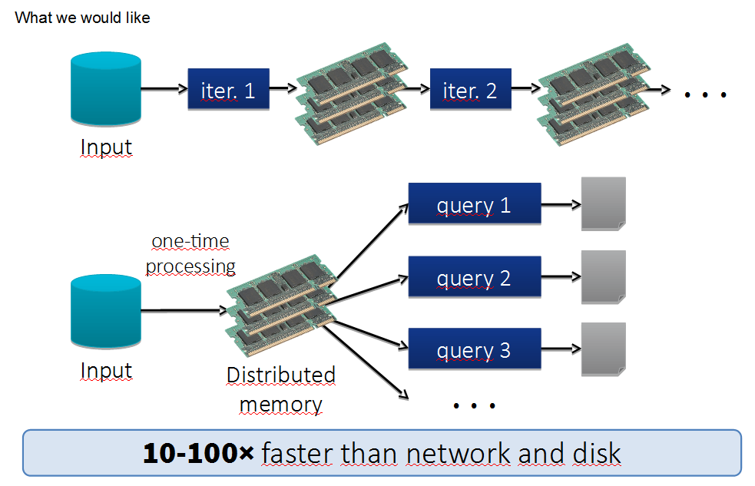
Spark Alternative
introduction to spark

Slide 16
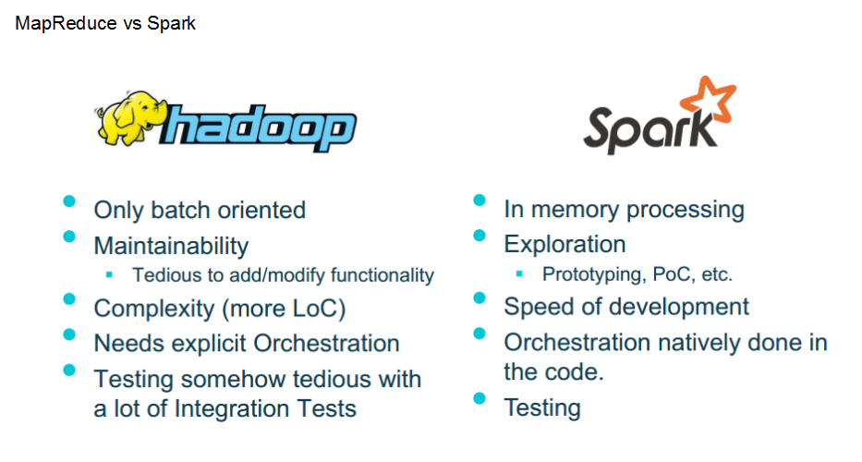
Spark vs Map-Reduce
introduction to spark
Multiple Map-Reduce and other operations can be managed in the same job

Slide 17
Exercise 1
introduction to spark
Word count Map Reduce

Slide 18
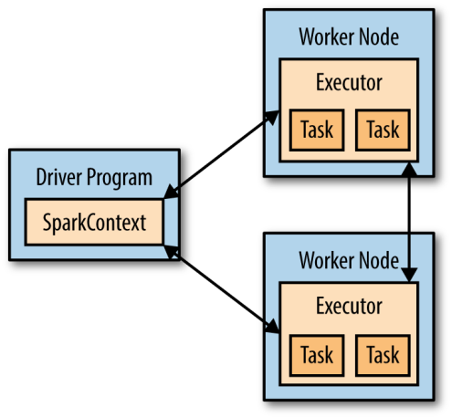
Basic Concepts
introduction to spark
Every Spark application consists of a driver program that defines distributed datasets on a cluster and then launches various parallel operations on them
The driver can be:
a shell that you can control interactively
a program in your local machine
a task in the cluster

Slide 19
Basic Concepts
introduction to spark
The driver accesses Spark through a SparkContext object which encapsulates the connection to the cluster
In the shell this object is created by default
The sc object

Slide 20

Basic Concepts
introduction to spark
In Spark computation on data is expressed as operations on distributed collections that are automatically parallelized across the cluster, called RDDs (Resilient Distributed Datasets).
To run these operations, the driver typically manages a number of nodes, called executors
The basic components are →

Slide 21
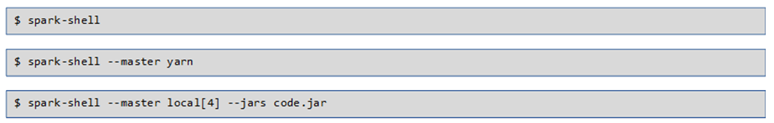
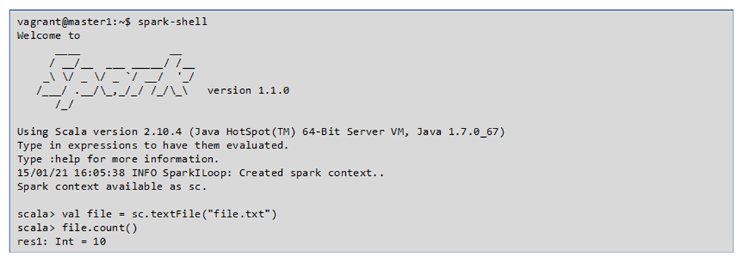
Using the Spark-Shell
introduction to spark

Slide 22
Spark Operations Example
introduction to spark
// Create an RDD called lines
scala> val lines = sc.textFile(“input/core-site.xml")
lines: spark.RDD[String] = MappedRDD[...]
scala> lines.count() // Count the number of items in this RDD
res0: Long = 127
scala> lines.first() // First item in this RDD, i.e. first line of README.md
res1: String = <?xml version="1.0"?>
scala> val hadoopLines = lines.filter(line => line.contains(“hadoop"))
hadoopLines: spark.RDD[String] = FilteredRDD[...]
scala> hadoopLines.first()
res2: String = " <name>hadoop.proxyuser.oozie.hosts</name>"

Slide 23
Building your own application
introduction to spark
When building your own driver program, the spark context must be defined
import org.apache.spark.SparkConf;
import org.apache.spark.api.java.JavaSparkContext;
SparkConf conf = new SparkConf().setMaster("local").setAppName("My App");
JavaSparkContext sc = new JavaSparkContext(conf);
// …
sc.stop()
A cluster URL. in this example local tells Spark how to connect to a cluster. local is a special value that runs Spark on one thread on the local machine, without connecting to a cluster.
An application name, My App in this example. This will identify your application on the cluster manager’s UI if you connect to a cluster

Slide 24
Building your own application
introduction to spark
For compiling add Spark core dependencies in the build.sbt project file
// additional libraries
libraryDependencies ++= Seq(
"org.apache.spark" %% "spark-core" % "1.5.0" % "provided"
)

Slide 25
Exercise 2
introduction to spark
Using the Spark shell

Slide 26
Introduction to spark
3. RDDs and Partitioning

Slide 27
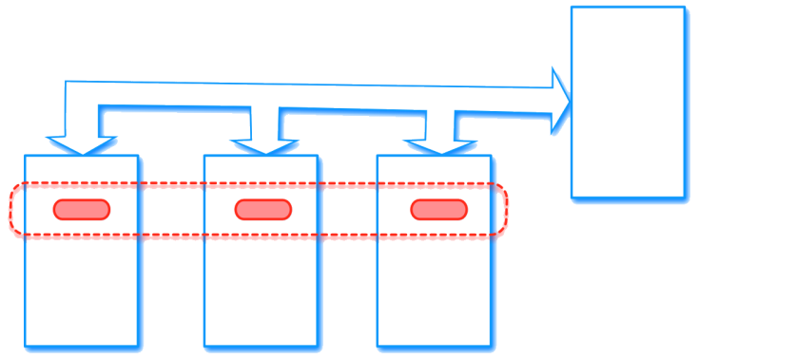
RDD Definition
introduction to spark
An RDD in Spark is simply an immutable distributed collection of objects.
Each RDD is split into multiple partitions, which may be computed on different nodes of the cluster.
RDDs can contain any type of objects:
Python
Java
R
Scala
user defined classes

Slide 28
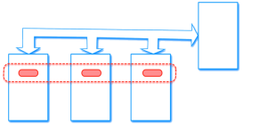
RDD Creation
introduction to spark
RDDs can be created in three ways:
By loading from an external dataset in HDFS, S3, local file, etc…
scala> val lines = sc.textFile("README.md")
Parallelizing a collection of objects already existing in the memory of the driver / workers
scala> val input = sc.parallelize(List(1, 2, 3, 4))
As a result of a transformation from another RDD
scala> val rdd2 = rdd1.filter(line => line.contains("error"))

Slide 29
RDD Basics
introduction to spark
Once created, RDDs offer two types of operations:
Transformations construct a new RDD from a previous one. For example, one common transformation is filtering data that matches a predicate.
val pythonLines = lines.filter(line => line.contains("Python"))
Actions compute a result based on an RDD, and either return it to the driver program or save it to an external storage system (e.g., HDFS).
scala> lines.first()

Slide 30
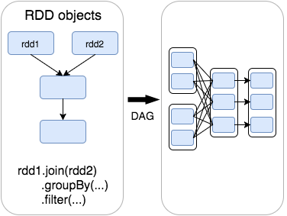
RDD Basics
introduction to spark
Sparks computes RDDs in a Lazy way. It sees the whole chain of transformations and compute just the data needed for its result the first time they are used in an action.
Spark’s RDDs are by default recomputed each time you run an action on them.
If you would like to reuse an RDD in multiple actions, you can ask Spark to persist it using RDD.persist().
Example:
scala> pythonLines.persist
scala> pythonLines.count()
2
scala> pythonLines.first()
u'## Interactive Python Shell'

Slide 31
Transformations
introduction to spark
This operation does not mutate the existing inputRDD.
Returns a pointer to an entirely new RDD.
inputRDD can be reused later
Lazy operations, returning new RDD
val inputRDD = sc.textFile("log.txt")
val errorsRDD = inputRDD.filter(line => line.contains("error"))
val warningsRDD = inputRDD.filter(line => line.contains("warning"))
val badLinesRDD = errorsRDD.union(warningsRDD)
Spark keeps track of the set of dependencies between different RDDs, called the lineage graph.
It uses this information to compute each RDD on demand and to recover lost data if part of a persistent RDD is lost.

Slide 32
Actions
Introduction to spark
Operations that return a final value to the driver program or write data to an external storage system.
Force the evaluation of the transformations required for the RDD
Example: counting errors
println("Input had " + badLinesRDD.count() + " bad lines")
println("Here are 10 examples:")
badLinesRDD.take(10).foreach(println)
Here we use take() to retrieve a small number of elements in the RDD at the driver program.
Iteration and print out is performed locally in the driver

Slide 33
Actions
Introduction to spark
RDDs also have a collect() function to retrieve the entire RDD.
This can be useful if your program filters RDDs down to a very small size and you’d like to deal with it locally.
Keep in mind that your entire dataset must fit in memory on a single machine to use collect()

Slide 34
Passing Functions to Spark
Introduction to spark
Most of Spark’s transformations, and some of its actions, depend on passing in functions that are used by Spark to compute data
We can pass in functions defined inline, references to methods, or static functions as we do for Scala’s other functional APIs
The function we pass and the data referenced in it needs to be serializable (@serializable)

Slide 35
Passing Functions to Spark
Introduction to spark
Passing a method or field of an object to a e.g. map of an RDD includes a reference to the whole object. Spark will then send the entire object to all worker nodes. To avoid this overhead, extract the needed fields as local variables
class SearchFunctions(val query: String) {
def getMatchesFunctionReference(rdd: RDD[String]): RDD[Boolean] = {
//Problem: "isMatch" is a class method, so "this.isMatch“. All of "this“ is passed
rdd.map(isMatch)
}
def getMatchesFieldReference(rdd: RDD[String]): RDD[Array[String]] = {
// Problem: "query" means "this.query", so we pass all of "this"
rdd.map(x => x.split(query))
}
def getMatchesNoReference(rdd: RDD[String]): RDD[Array[String]] = {
// Safe: extract just the field we need into a local variable
val query_ = this.query
rdd.map(x => x.split(query_))
}
}

Slide 36
Common Transformations And Actions
Introduction to spark
Map & Filter
val input = sc.parallelize(List(1, 2, 3, 4))
val result = input.map(x => x * x)
val resultF = input.filter(x => x != 1)

Slide 37
Common Transformations And Actions
Introduction to spark
Flatmap
val lines = sc.parallelize(List("hello world", "hi"))
val words = lines.flatMap(line => line.split(" "))
words.first() // returns "hello"

Slide 38
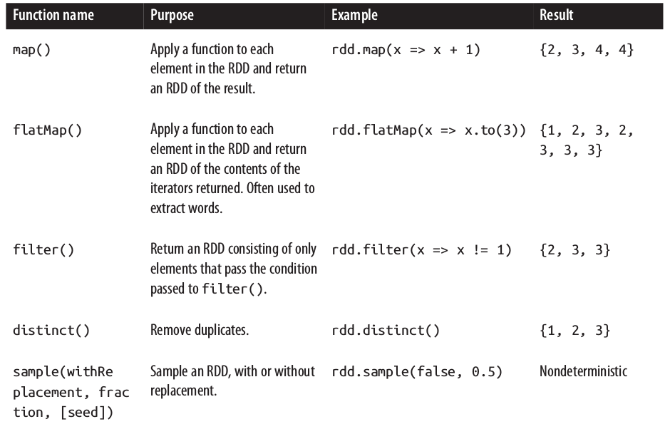
Basic RDD transformations
Introduction to spark
RDD containing
{1, 2, 3, 3}

Slide 39
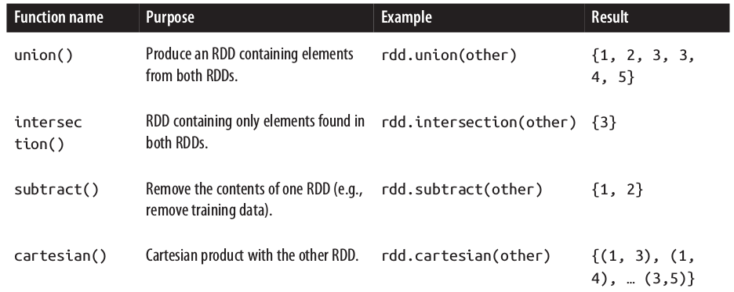
Two-RDD transformations
Introduction to spark
Two RDDs containing {1, 2, 3} and {3, 4, 5}

Slide 40
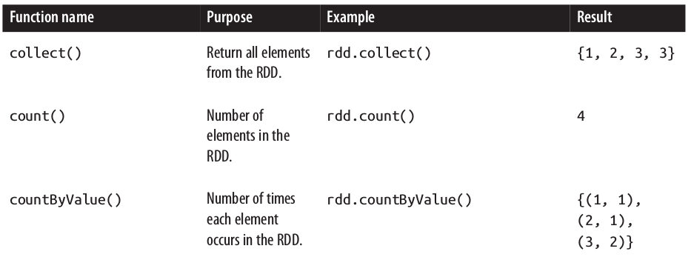
RDD Basic Actions
Introduction to spark
RDD contains {1, 2, 3, 3}

Slide 41
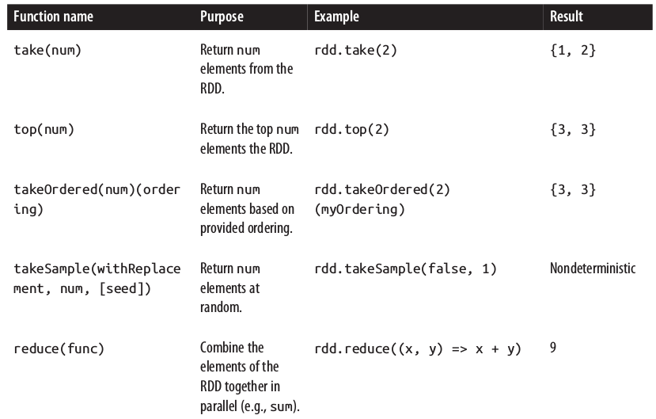
RDD Other Actions
Introduction to spark
RDD
{1, 2, 3, 3}

Slide 42
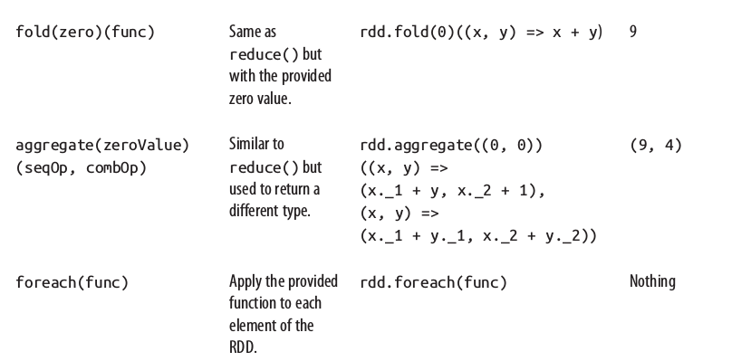
RDD Other Actions
Introduction to spark
RDD
{1, 2, 3, 3}

Slide 43
Key/Value Pairs RDDs
Introduction to spark
Spark provides special operations on RDDs containing (key, value) pairs
They expose operations that allow you to act on each key in parallel, regroup or aggregate data across the network.
Many formats loading return pair RDDs for key/value data.
Parallelize (for testing and pocs)
val pairs = sc.parallelize (List((1,”a”),(2,”b”),(3,”c”)))
Running transformations over regular RDDs
//pair RDD using the first word as the key
val pairs = lines.map(x => (x.split(" ")(0), x))

Slide 44
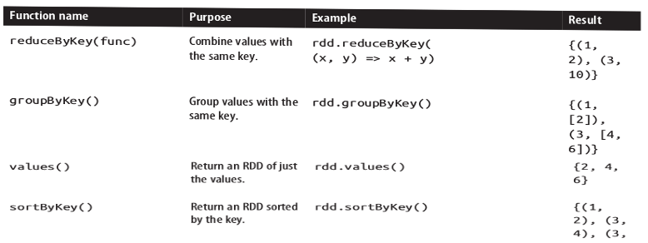
Pair RDD Operations
Introduction to spark
Transformations on one pair RDD: {(1, 2), (3, 4), (3, 6)}

Slide 45
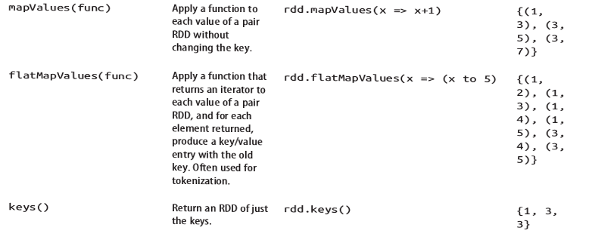
Pair RDD Operations
Introduction to spark
Transformations on one pair RDD: {(1, 2), (3, 4), (3, 6)}

Slide 46
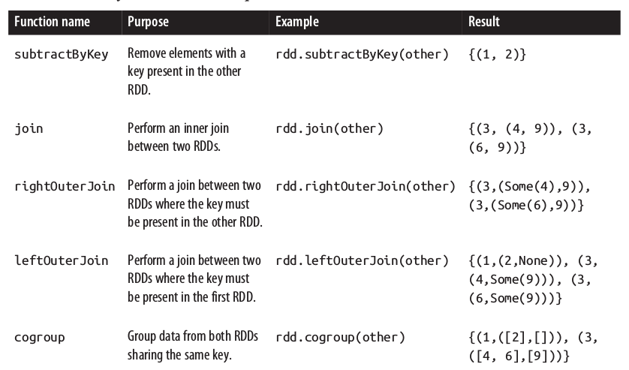
Pair RDD Operations
Introduction to spark
Two RDDs of Paris rdd = {(1, 2), (3, 4), (3, 6)} other = {(3, 9)})

Slide 47
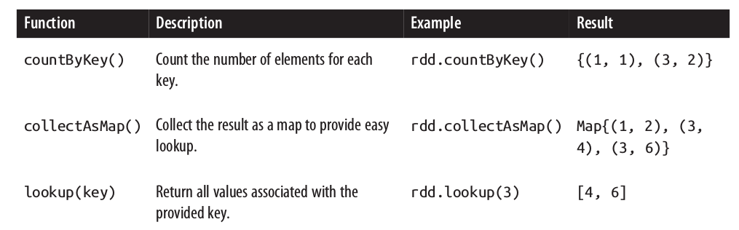
Pair RDD Operations
Introduction to spark
Actions on (key, value) RDDs {(1, 2), (3, 4), (3, 6)}

Slide 48
Exercises
introduction to spark
Exercise 3 WordCount Spark
Exercise 4 Top-10 WordCount
Exercise 5 Aggregation by Key
Exercise 6 Combine RDDs

Slide 49
Persistence (caching)
introduction to spark
Remember: in Spark the RDD is computed again each time an action is called
val result = input.map(x => x*x)
// result.persist (StorageLevel.LEVEL)
println(result.count())
println(result.collect().mkString(","))
To avoid this we can persist the data, especially with iterative algorithms.
Each node stores their partitions of the RDD
the default persist() will store the data in the JVM heap (memory) as unserialized objects

Slide 50
Persistence (caching)
introduction to spark
If a node that has data persisted on it fails, Spark will recompute the lost partitions of the data as needed.
If you attempt to cache too much data to fit in memory, Spark will automatically evict old partitions using a Least Recently Used (LRU) cache policy.
RDDs come with a method called unpersist() that lets you manually remove them from the cache

Slide 51
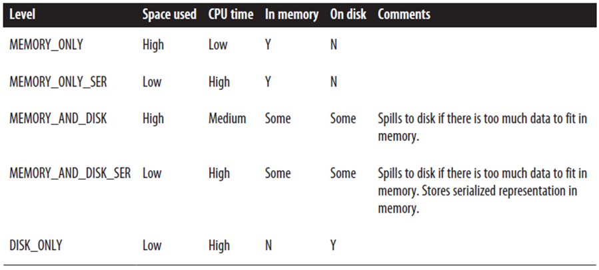
Persistence Levels
introduction to spark
cache() = persist(StorageLevel.MEMORY_ONLY)

Slide 52
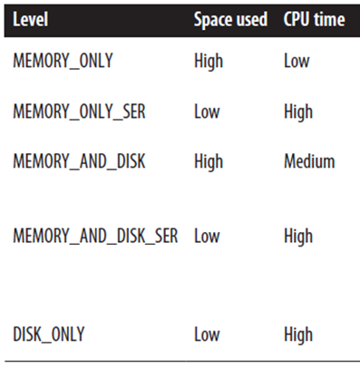
Persistence Levels
introduction to spark
Which storage level to choose?
Use MEMORY_ONLY if there is memory enough
If not MEMORY_ONLY_SER
Spill to disk only if
the functions that computed your RDDs are expensive
or they filter a large amount of the data
Otherwise, re computing a partition is faster than reading from disk

Slide 53
Exercises
introduction to spark
Exercise 7 Data Mining with MovieLens

Slide 54
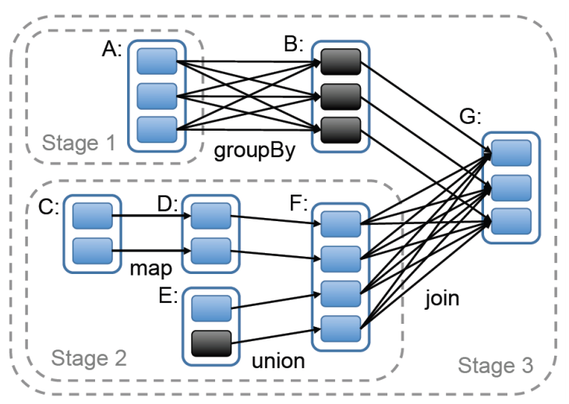
Spark Data Transformations
introduction to spark
Logic View
Wide Transformations
Narrow
Transformations
Wide Transformations

Slide 55

Spark Workflow – Partitions (1/2)
introduction to spark
val sc = new SparkContext(“spark://...”, “MyJob”, home, jars) val file = sc.textFile(“hdfs://...”) val errors = file.filter(_.contains(“ERROR”)) errors.count()
Dataset-level view
Partition-level view
HadoopRDD path = hdfs://...
file:
errors:
FilteredRDD func = _.contains(…)

Slide 56
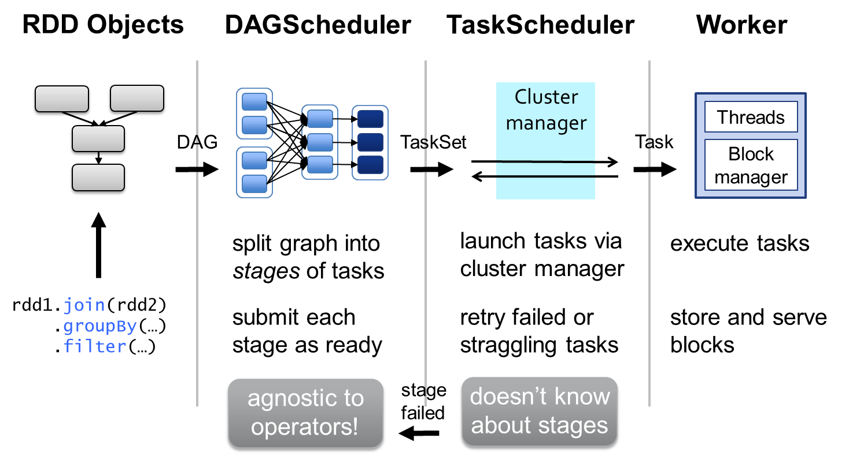
Spark Workflow – the rest (2/2)
introduction to spark

Slide 57
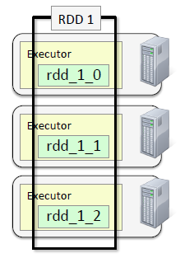
Data Partitioning -- default
introduction to spark
Partitioning defines the degree of parallelism by “partitioning” the data between workers. Then in each worker the data will be processed in parallel
By default is done automatically by Spark
spark.default.parallelism
In local mode the default is #cores
In cluster mode the default is #total number of cores

Slide 58
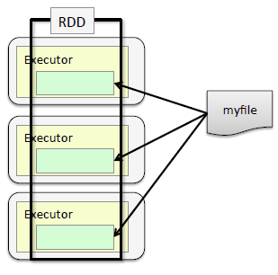
Data Partitioning – single small files
introduction to spark
Small – less than 1 HDFS block
Partitions based in size
Optionally minimum can be specified
textFile(file, minPartitions)
Default is 2
More partitions → more parallelization

Slide 59
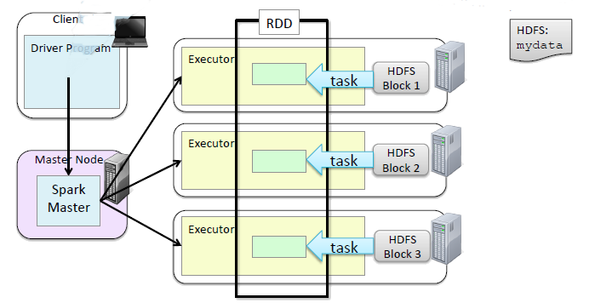
Data Partitioning – single big files
introduction to spark
big – more than 1 HDFS block
Default – one block / one partition

Slide 60
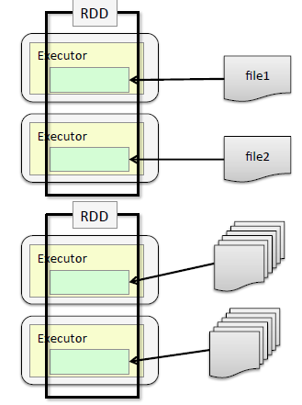
Data Partitioning – multiple small files
introduction to spark
textFile(file, minPartitions)
Each file becomes (at least) one partition
File-based operations can be done per partition
For many small files treat them as a single key-value RDD
key = file name
value = file contents
can be partitioned in a custom way – see later

Slide 61
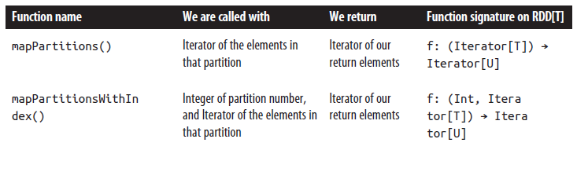
Data Partitioning – operations
introduction to spark
Most operations work on each element of an RDD
Few work on each partition – avoid element setup overhead
Functions per partitions take iterators

Slide 62
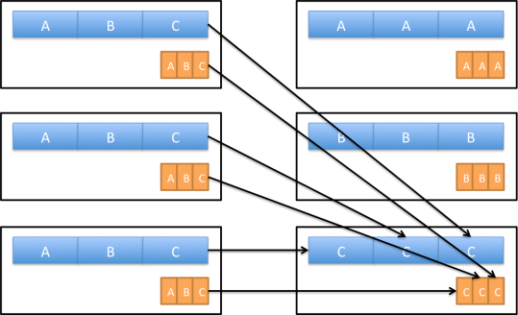
Data Partitioning for Key/Value RDDs
introduction to spark
Partitioning is available for all RDDs of key/value pairs
It causes the system to group elements based on a function of each key.
Spark does not give explicit control of which worker node each key goes to but it lets the program ensure that a set of keys will appear together on the same node somewhere.
For example, you might choose to hash-partition an RDD into 100 partitions so that keys that have the same hash value modulo 100 appear on the same node

Slide 63
Data Partitioning
introduction to spark
Example (works but it is not efficient)
// Initialization code; we load the user info from a Hadoop SequenceFile on HDFS.
// This distributes elements of userData by the HDFS block where they are found,
// and doesn't provide Spark with any way of knowing in which partition a
// particular UserID is located.
val sc = new SparkContext(...)
val userData = sc.sequenceFile[UserID, UserInfo]("hdfs://...").persist()
// Function called periodically to process a logfile of events in the past 5 minutes;
// we assume that this is a SequenceFile containing (UserID, LinkInfo) pairs.
def processNewLogs(logFileName: String) {
val events = sc.sequenceFile[UserID, LinkInfo](logFileName)
val joined = userData.join(events)// RDD of (UserID, (UserInfo, LinkInfo)) pairs
val offTopicVisits = joined.filter {
case (userId, (userInfo, linkInfo)) => // Expand the tuple into its components
…
}.count()
println("Number of visits to non-subscribed topics: " + offTopicVisits)
}

Slide 64
Data Partitioning
introduction to spark
Why is not efficient?
The join() operation is called each time processNewLogs() is invoked.
It does not know anything about how the keys are partitioned in the datasets, so the userData table is hashed and shuffled across the network on every call, even though it doesn’t change.
Because we expect the userData table to be much larger than the small log of events seen every five minutes, this wastes a lot of work:

Slide 65
Data Partitioning - Solution
introduction to spark
Use org.apache.spark.HashPartitioner with
the transformation partitionBy():
val sc = new SparkContext(...)
val userData = sc.sequenceFile[UserID, UserInfo]("hdfs://...")
.partitionBy(new HashPartitioner(100))
//Create 100 partitions
.persist()
Because we called partitionBy()when building userData, Spark will now know that it is hash-partitioned, and calls to join() on it will take advantage of this information. When we call user Data.join(events), Spark will shuffle only the events RDD, sending events with each particular UserID to the machine that contains the corresponding hash partition of userData

Slide 66
Data Partitioning -- Solution
introduction to spark
It is important to persist userData otherwise subsequent uses of the RDD will result in complete lineage revaluation, repeated partitioning and shuffling data across the network
The number of partitions control how many parallel tasks will be performed on the RDD (e.g. joins)
at least as large of the number of cores in the cluster
or even slightly more
It’s possible use others (RangePartitioner) or implement our own partitioner from org.apache.spark.Partitioner

Slide 67
Define the RDD Data Partitioner
introduction to spark
scala> val pairs = sc.parallelize(List((1, 1), (2, 2), (3, 3)))
pairs: spark.RDD[(Int, Int)] = ParallelCollectionRDD[0] at parallelize at <console>:12
scala> pairs.partitioner
res0: Option[spark.Partitioner] = None
scala> import org.apache.spark.HashPartitioner
import org.apache.spark.HashPartitioner
scala> val partitioned = pairs.partitionBy(new HashPartitioner(2)).persist()
partitioned: spark.RDD[(Int, Int)] = ShuffledRDD[1] at partitionBy at <console>:14
scala> partitioned.partitioner
res1: Option[spark.Partitioner] = Some(spark.HashPartitioner@5147788d)

Slide 68
When RDD Data Partitioning
introduction to spark
Operations That Benefit from Partitioning
One RDD: All the values for each key to be computed locally on a single machine, requiring only the final, locally reduced value to be sent from each worker node back to the master
groupByKey(), reduceByKey(), lookup()
Two RDD: -At least one of the RDDs will not be shuffled. -If both have the same partitioner and cached on the same server (eg. One was created from other using mapValues) then no shuffling will occur.
cogroup(), join(), leftOuterJoin(), rightOuterJoin()
Operations That Affect Partitioning
if you call map() on a hash-partitioned RDD of key/value pairs, the function passed to map() can in theory change the key of each element, so the result will not have a partitioner
Therefore, operations that result in a partitioner being set on the output RDD:
cogroup(), join(), leftOuterJoin(), rightOuterJoin(), groupByKey(), reduceByKey(), partitionBy(), sort()
If the parent RDD has a partitioner: mapValues(), flatMapValues(),filter()

Slide 69
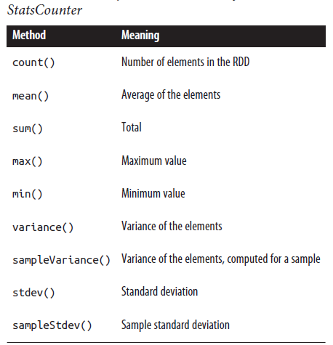
Numeric RDD Operations
introduction to sparK
Spark provides several descriptive statistics operations on RDDs containing numeric data
The descriptive statistics are all computed in a single pass over the data and returned as a StatsCounter object by calling stats().
// remove outliers since those may have misreported locations
// first we need to take our RDD of strings and turn it into doubles.
val distanceDouble = distance.map(string => string.toDouble)
val stats = distanceDoubles.stats()
val stddev = stats.stdev
val mean = stats.mean
val reasonableDistances = distanceDoubles.filter(x => math.abs(x-mean) < 3 * stddev)
println(reasonableDistance.collect().toList)

Slide 70
Exercises
introduction to spark
Exercise 8 Transformations per partition

Slide 71
Introduction to spark
4. Spark Architecture

Slide 72
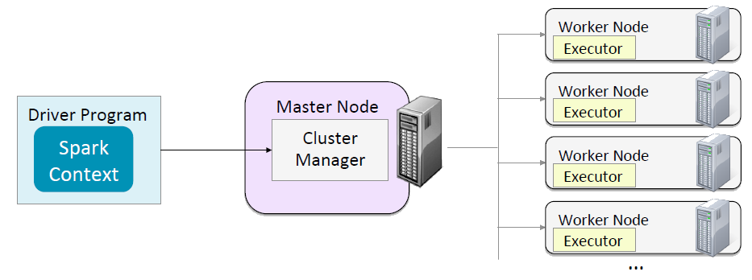
Spark Runtime architecture
introduction to sparK
Master/slave architecture
Central coordinator driver (own java process)
Daemons on workers called executor (own java process)
Driver + executors = Spark application
Application is launched using a cluster manager

Slide 73
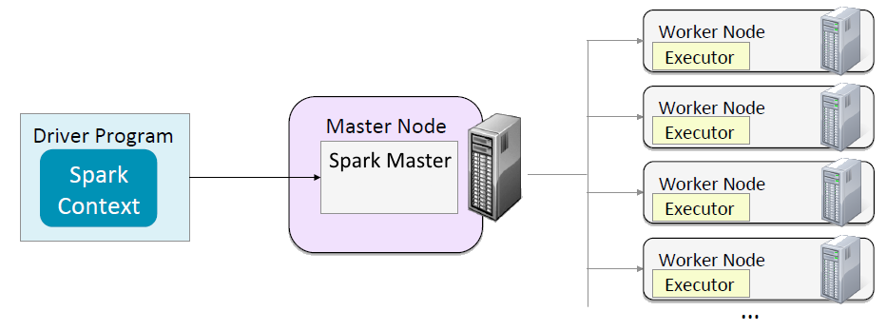
Spark Standalone Cluster -- Daemons
introduction to sparK
Spark Master
One per cluster
Manages applications, distributes tasks to Spark Workers
Spark Worker
One per worker node
Starts monitors Executors for applications

Slide 74
Launching a program
introduction to sparK
Single script spark-submit with options to connect to clusters and control resources
The user submits an application using spark-submit.
spark-submit launches the driver program and invokes the main() method specified by the user.
The driver program contacts the cluster manager to ask for resources to launch executors.
The cluster manager launches executors on behalf of the driver program.
The driver process runs through the user application. Based on the RDD actions and transformations in the program, the driver sends work to executors in the form of tasks.
Tasks are run on executor processes to compute and save results.
If the driver’s main() method exits or it calls SparkContext.stop(), it will terminate the executors and release resources from the cluster manager.

Slide 75
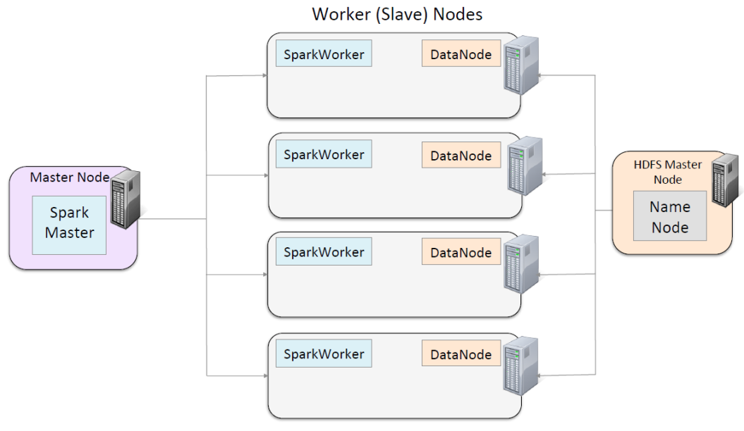
Spark Standalone Cluster Workflow (1/5)
introduction to sparK

Slide 76
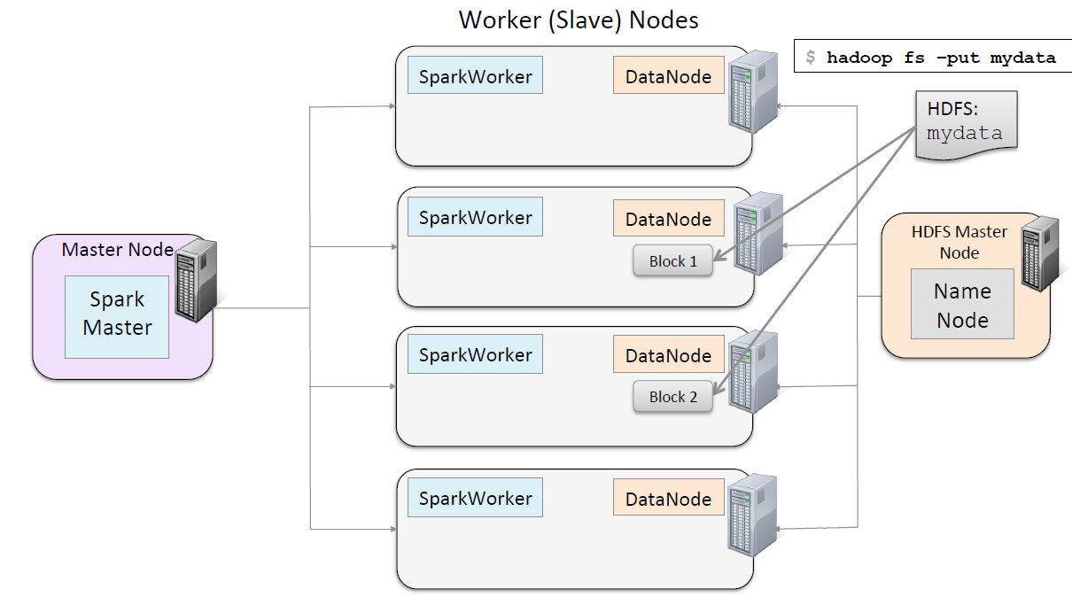
Spark Standalone Cluster Workflow (2/5)
introduction to sparK

Slide 77
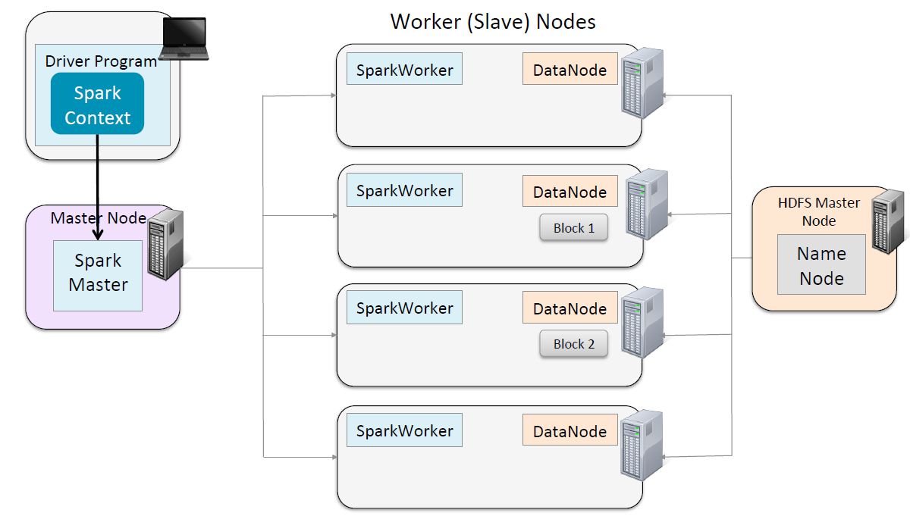
Spark Standalone Cluster Workflow (3/5)
introduction to sparK

Slide 78
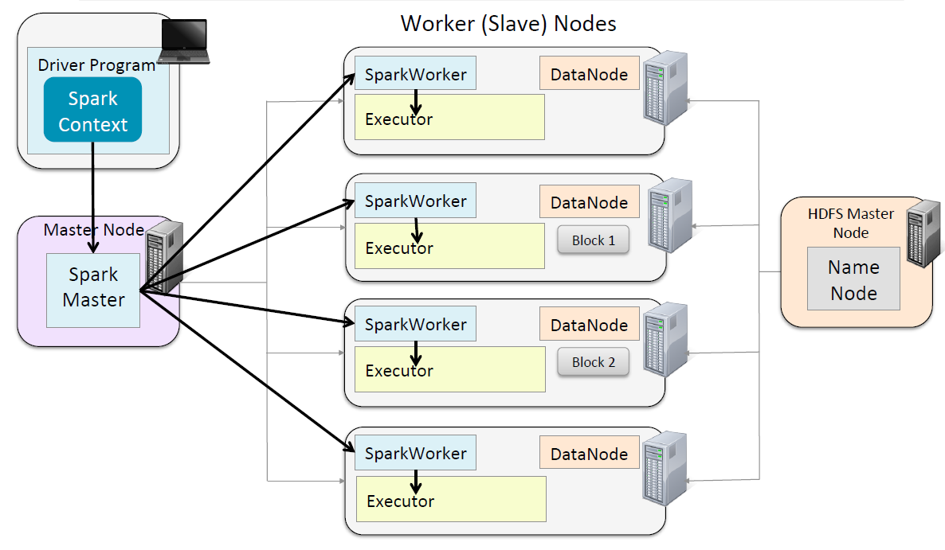
Spark Standalone Cluster Workflow (4/5)
introduction to sparK

Slide 79
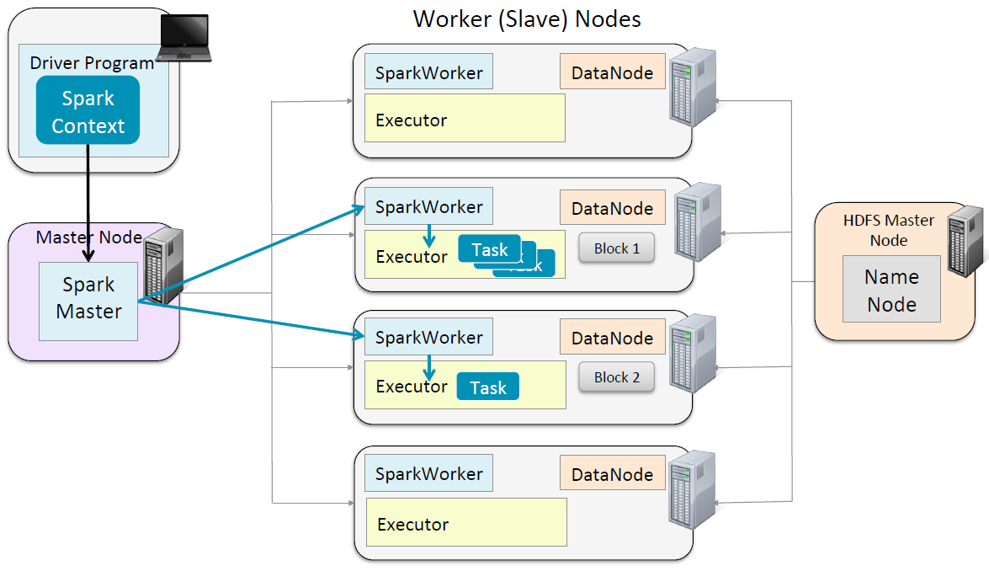
Spark Standalone Cluster Workflow (5/5)
introduction to sparK

Slide 80

Spark on local mode
introduction to sparK
The Spark Context, the Spark Master (cluster manager) and the Worker node are threads in a single JVM
The number of workers (threads) are set at spark-shell invocation
spark-shell –master local[#threads]
JVM

Slide 81
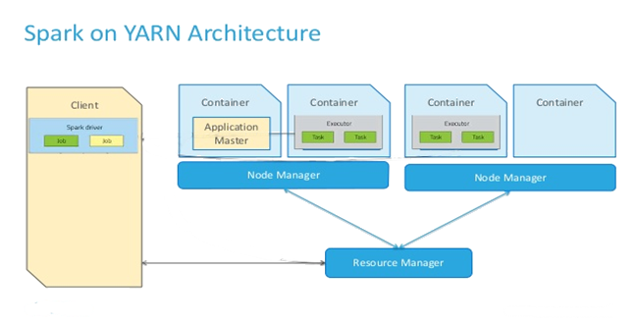
Spark with other cluster managers
introduction to sparK
Spark can run the Executors and the Master with other cluster managers (YARN, Mesos)
Executors and the Master are run as tasks managed by the cluster manager
Cluster manager provides scalability, fault tolerance, multi-jobs

Slide 82
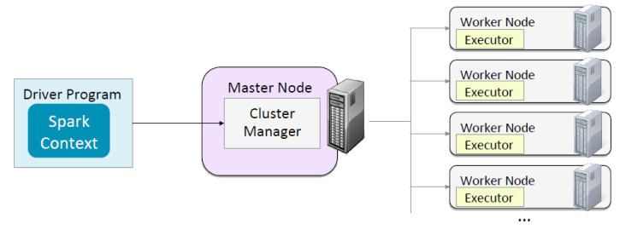
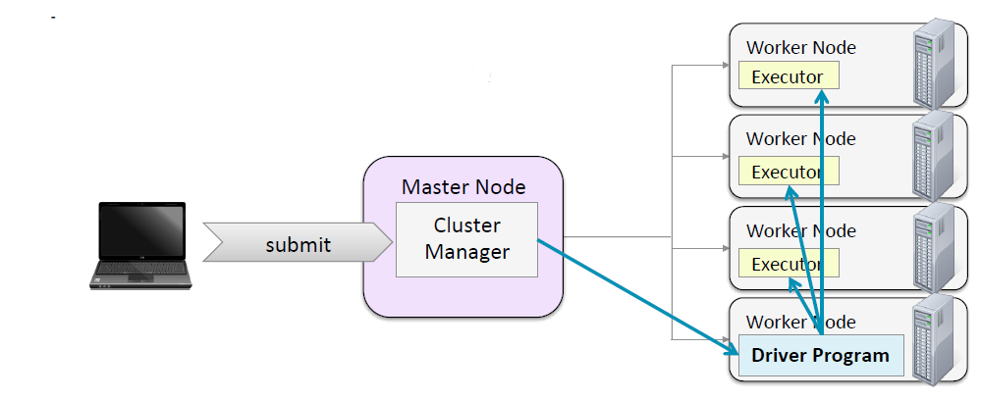
Spark modes with other cluster managers
introduction to sparK
Two modes exist, depending where the driver is run
Client mode: the driver is outside the cluster (spark-shell)
Cluster mode: the driver is another task in the cluster (no spark-shell)

Slide 83
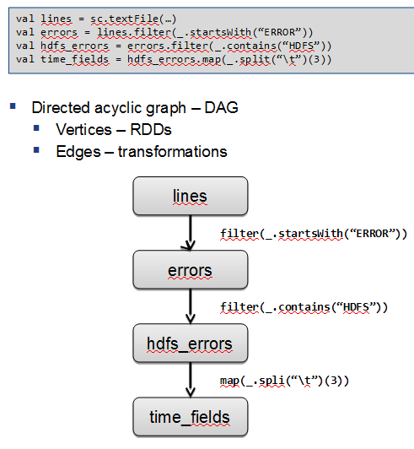
The Driver
introduction to sparK
Is the process where the main() method of your program runs
It is the process running the user code that creates a SparkContext, creates RDDs, and indicates transformations and actions

Slide 84
The Driver – duties
introduction to sparK
Converts a user program into tasks:
Creates a logical directed acyclic graph (DAG) of operations.
Converts DAG into a physical execution plan
Creates a series of stages based on DAG optimizing transformations and merging them
Each stage consists of multiple tasks (smallest unit of work). They are bundled up and sent to the cluster
Schedules tasks on executors
Uses physical execution plan
At start executors register themselves to the driver. Each executor can run task and store RDD slices
Based on data placement the driver schedule each task to a worker
Driver tracks the location of cached data

Slide 85
Executors
introduction to sparK
Java processes responsible for running individual tasks in a Spark job
Two roles
Run the tasks and return results to the driver
Provide in-memory storage for RDDs through a service called Block Manager

Slide 86
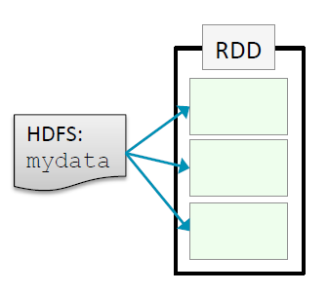
Execution Components – Example (1/5)
introduction to sparK
Average work length by letter
$ var avg_length = sc.textFile(fileName)

Slide 87
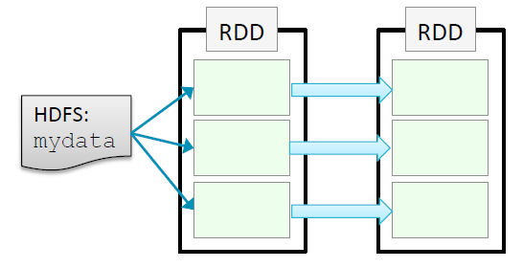
Execution Components – Example (2/5)
introduction to sparK
Average work length by letter
$ var avg_length = sc.textFile(fileName).flatMap(line => line.split(“ “)

Slide 88
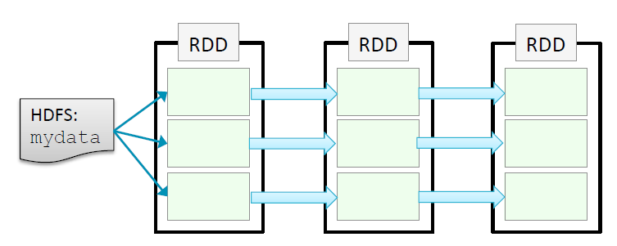
Execution Components – Example (3/5)
introduction to sparK
Average work length by letter
$ var avg_length = sc.textFile(fileName).flatMap(line => line.split(“ “)
$ | .map( word => (word[0], word.length)

Slide 89
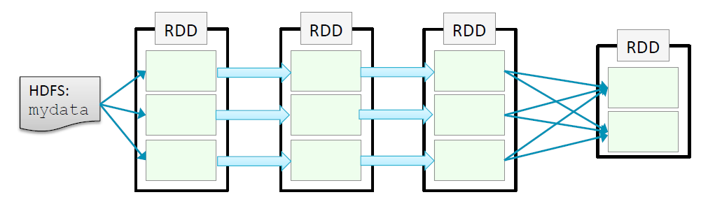
Execution Components – Example (4/5)
introduction to sparK
Average work length by letter
$ var avg_length = sc.textFile(fileName).flatMap(line => line.split(“ “)
$ | .map( word => (word[0], word.length)
$ | .groupByKey()

Slide 90
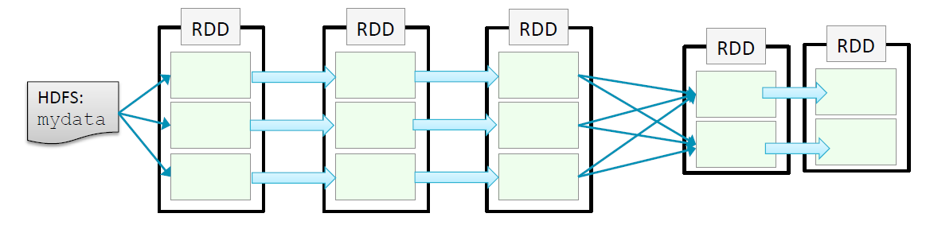
Execution Components – Example (5/5)
introduction to sparK
Average work length by letter
$ var avg_length = sc.textFile(fileName).flatMap(line => line.split(“ “)
$ | .map( word => (word[0], word.length)
$ | .groupByKey()
$ | .map((key,values) => sum(values)/values.length)

Slide 91
Components of Execution (1/4)
introduction to sparK
At this time there are no actions. Only the DAG has been created.
To display the lineage of the RDDs we can use toDebugString
Stages and Tasks are identified
Stages: group of operations that can be run on the same partition
Tasks: parallel transformations inside a stage
To improve performance should be aware of the stages

Slide 92
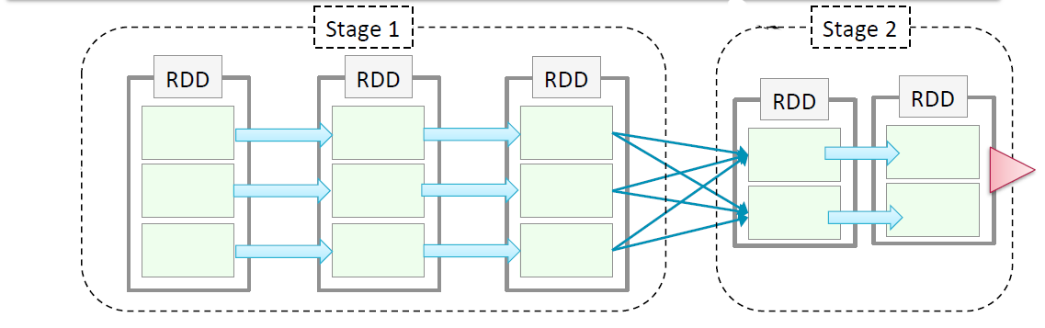
Components of Execution (2/4) – Stages
introduction to sparK
$ var avg_length = sc.textFile(fileName).flatMap(line => line.split(“ “)
$ | .map( word => (word[0], word.length)
$ | .groupByKey()
$ | .map((key,values) => sum(values)/values.length)
$ avg_length.count()

Slide 93
Components of Execution (3/4) – Scheduler
introduction to sparK
The Scheduler performs pipelining, or the collapsing of computation of multiple RDDs into a single stage.
Pipelining occurs when RDDs can be computed from their parents without data movement
Each stage has tasks for each partition in that RDD
Spark’s internal scheduler may truncate the lineage of the RDD graph if an existing RDD has already been persisted

Slide 94
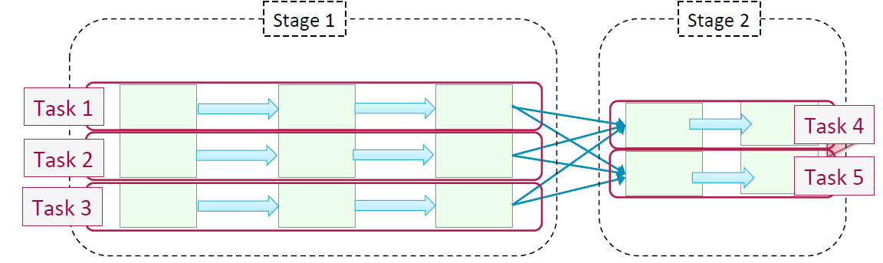
Components of Execution (4/4) – Tasks
introduction to sparK
$ var avg_length = sc.textFile(fileName).flatMap(line => line.split(“ “)
$ | .map( word => (word[0], word.length)
$ | .groupByKey()
$ | .map((key,values) => sum(values)/values.length)
$ avg_length.count()

Slide 95
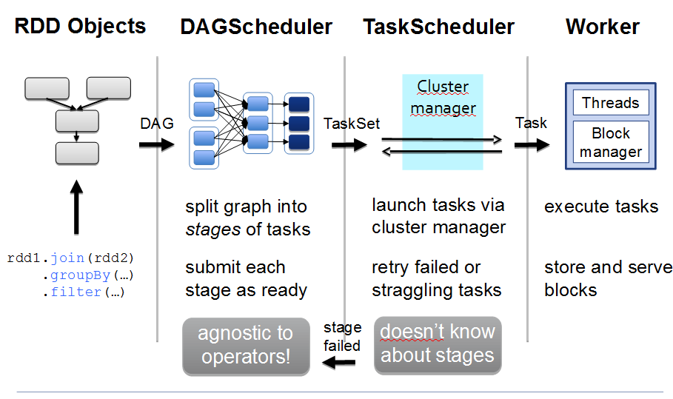
Driver / executor steps
introduction to sparK

Slide 96

Summary
introduction to sparK
Application: represented by a SparkContext. Serves several jobs, RDD and shared variables
Job – a set of tasks executed as a result of an action (arbitrary DAG)
Stage – a set of tasks in a job that can be executed in parallel
Task – an individual unit of work sent to one executor

Slide 97
Spark Configuration
introduction to sparK
Primary mechanism: SparkConf
val conf = new SparkConf()
conf.set("spark.app.name", "My Spark App")
conf.set("spark.master", "local[4]")
conf.set("spark.ui.port", "36000") // Override the default port
// Create a SparkContext with this configuration
val sc = new SparkContext(conf)
SparkConf provides methods to set common params like setAppName() and setMaster ()
Spark-submit provides flags for most common config and –conf to setup any configuration value
$ bin/spark-submit \
--class com.example.MyApp \
--master local[4] \
--name "My Spark App" \
--conf spark.ui.port=36000 \
myApp.jar

Slide 98
Spark Configuration
introduction to sparK
Spark-submit by default reads the conf/spark-default.conf file
- this file location can be customized
$ bin/spark-submit \
--class com.example.MyApp \
--properties-file my-config.conf \
myApp.jar
## Contents of my-config.conf ##
spark.master local[4]
spark.app.name "My Spark App"
spark.ui.port 36000
For a full list of configuration options see the Spark documentation
http://spark.apache.org/docs/latest/configuration.html

Slide 99
Spark web UI (1/2)
introduction to sparK
Available at http://<server-driver>:4040
YARN: http://<ResourceManager>:4040
Jobs: Progress and metrics of stages, tasks, and more
Storage: Information for RDDs that are persisted
Executors: A list of executors present in the application
Environment: Debugging Spark’s configuration

Slide 100

Spark web UI (2/2)
introduction to sparK

Slide 101
Drivers and Executor logs in cluster
introduction to sparK
YARN
yarn logs -applicationId <app ID> when app has finished (logs are agregated)
In a Running Application:
click through the ResourceManager UI to the Nodes page, then browse to a particular node, and from there, a particular container

Slide 102
Performance Tuning
introduction to sparK
Level of Parallelism
Too little parallelism
Idle resources
Tasks to big. If more tasks than processors, waiting for the last task in the queue can be a problem
Be aware of memory/disk space for shuffle
Too much parallelism
Overhead for each partition computation
Network traffic
Done
A
B
C
D1
D2
Waiting for this to finish

Slide 103
Performance Tuning
introduction to sparK
What to tune
In operations that shuffle data you can set the degree of parallelism via parameter
A RDD can be distributed to have more or fewer partitions
repartition() shuffle a RDD into desired number of partitions
coalesce() to shrinking partitions and avoid shuffling
# Wildcard input that may match thousands of files
>>> input = sc.textFile("s3n://log-files/2014/*.log")
>>> input.getNumPartitions()
35154
# A filter that excludes almost all data
>>> lines = input.filter(lambda line: line.startswith("2014-10-17"))
>>> lines.getNumPartitions()
35154
# We coalesce the lines RDD before caching
>>> lines = lines.coalesce(5).cache()
>>> lines.getNumPartitions()
5
# Subsequent analysis can operate on the coalesced RDD...
>>> lines.count()

Slide 104
Serialization
introduction to sparK
Use Kryo (faster than the default java serialization)
val conf = new SparkConf()
conf.set("spark.serializer", "org.apache.spark.serializer.KryoSerializer")
// Be strict about class registration
conf.set("spark.kryo.registrationRequired", "true")
conf.registerKryoClasses(Array(classOf[MyClass], classOf[MyOtherClass]))

Slide 105
Exercises
introduction to sparK
Exercise 9: Viewing Stages in the Spark Application UI

Slide 106

Shared Variables
introduction to sparK
Functions (map, filter,…) can use variables defined outside them in the driver program
But each task running on the cluster gets a its own copy of each variable
Updates from these copies not return to driver
Accumulators & Broadcast variables relax this restriction for aggregation and broadcasts

Slide 107
Shared variables – Accumulators
introduction to sparK
Aggregation values from workers to the driver
For example count some kind of events during job execution
Accumulator of empty line counts in Scala:
val file = sc.textFile("file.txt")
// Create an Accumulator[Int] initialized to 0
val blankLines = sc.accumulator(0)
val callSigns = file.flatMap(line => {
if (line == "") {
// Add to the accumulator
blankLines += 1
}
line.split(" ")
})
callSigns.saveAsTextFile("output.txt")
println("Blank lines: " + blankLines.value)
we will see the right count only after we run the saveAsTextFile() action, because the transformation above it, map(), is lazy
accumulators are write-only variables. This allows accumulators to be implemented efficiently

Slide 108

Shared variables – Accumulators
introduction to sparK
Accumulators and Fault tolerance
The same function may run multiple times on the same data
An operation crashes
A node is slow and a “speculative” copy of the task is launched on other node
Rebuild of a cached value that falls out of memory
For accumulators used in actions, Spark applies each task’s update to each accumulator only once (can be used actions like foreach() and is OK)
But for accumulators used in RDD transformations instead of actions, this guarantee does not exist (use only for debugging, NOT OK)

Slide 109
Shared Variables – Broadcast
introduction to sparK
Broadcast variables, allow the program to efficiently send a large, read-only value to all the worker nodes for use in one or more Spark operations
Like send a large, read-only lookup table to all the nodes
Sparks send all variables in your closures to the worker nodes but can be inefficient:
The default task launching mechanism is optimized for small task sizes
You might, in fact, use the same variable in multiple parallel operations, but Spark will send it separately for each operation
Broadcast variables are read-only
Example
val signPrefixes = sc.broadcast(loadCallSignTable())
val countryContactCounts = contactCounts.map{ case(sign, count) =>
val country = lookupInArray(sign, signPrefixes.value)
(country, count)
}.reduceByKey((x, y) => x + y)
countryContactCounts.saveAsTextFile(outputDir + "/countries.txt")

Slide 110
Exercises
introduction to sparK
Exercise 10: Using Broadcast Variables
Exercise 11: Using Accumulators
Exercise 12: Average WordLength

Slide 111
Introduction to spark
4. Spark Architecture Load and Save Data

Slide 112

Load and Save Data
introduction to spark
Spark can access data used by Hadoop (S3, HDFS, Cassandra Hbase, etc…) and local filesystem
Common supported file formats

Slide 113
Load and Save Data – Text Files
introduction to sparK
val input = sc.textFile(“/user/gftbigdata/input-spark/core-site.xml")
Multiples Files (in pair RDD, key name of file)
Support directories & wildcards
Average value per file (key – filename; value – file contents)
val input = sc.wholeTextFiles("file:///home/holden/salesFiles")
val result = input.mapValues{ y =>
val nums = y.split(" ").map(x => x.toDouble)
nums.sum / nums.size.toDouble
}

Slide 114
Load and Save Data
Text Files
val input = sc.textFile("file:///home/holden/repos/spark/README.md")
Multiples Files (in pair RDD, key name of file)
Support directories & wildcards
Average value per file
val input = sc.wholeTextFiles("file:///home/holden/salesFiles")
val result = input.mapValues{y =>
val nums = y.split(" ").map(x => x.toDouble)
nums.sum / nums.size.toDouble
introduction to sparK
Loading CSV with textFile() in Scala and opencsv Library
No newline inside a field
import java.io.StringReader
import au.com.bytecode.opencsv.CSVReader
...
val input = sc.textFile(inputFile)
val result = input.map( line =>
val reader = new CSVReader(new StringReader(line));
reader.readNext();
)
New lines inside a field
case class Person(name: String, favoriteAnimal: String)
val input = sc.wholeTextFiles(inputFile)
val result = input.flatMap( case (_, txt) =>
val reader = new CSVReader(new StringReader(txt));
reader.readAll().map(x => Person(x(0), x(1)))
)
(FileName, content)

Slide 115
Load and Save Data
introduction to sparK
Saving RDD as a text file
result.saveAsTextFile(outputFile)
For CVS: Write a function that converts the fields to given positions in an comma separated line and save as text file.

Slide 116
Load and Save Data -- Sequence Files
introduction to sparK
Flat files with key/value pairs
Sync markers that allow Spark read SequenceFiles in parallel from multiples nodes
The elements implement Hadoop’s Writable Interface Like IntWritable, Text …
Add dependencies for hadoop to your sbt project
Always map the loading to Scala types for doing computations.
val data = sc.sequenceFile(inFile, classOf[Text], classOf[IntWritable])
.map{case (x, y) => (x.toString, y.get())}
Or use sequenceFile[Key, Value](path) that returns native Scala types

Slide 117
Load and Save Data -- Sequence Files
introduction to sparK
Saving sequenceFile
val data = sc.parallelize(List(("Panda", 3), ("Kay", 6), ("Snail", 2)))
data.saveAsSequenceFile(outputFile)

Slide 118
Load and Save Data – Hadoop
introduction to sparK
Spark also can interact with Hadoop input and output formats
Example loading with new KeyValueTextInputFormat for reading key/value data from text files
val input = sc.newAPIHadoopFile[Text, Text, KeyValueTextInputFormat](inputFile).map {
case (x, y) => (x.toString, y.toString)
}
Example saving with a sequence file output format
result.saveAsNewAPIHadoopFile(fileName, Text.class, IntWritable.class, SequenceFileOutputFormat.class);

Slide 119
Load and Save data – File Systems
introduction to sparK
Local filesystem:
Requires that the files are available at the same path on all nodes in your cluster. If not load locally on the driver and then parallelize
val rdd = sc.textFile(“file:///home/gftbigdata/hola.txt”)
Amazon S3:
Set AWS_ACCESS_KEY_ID and AWS_SECRET_ACCESS_KEY environment variables in each worker
Fast if nodes are in EC2
val rdd = sc.textFile(“s3n://bucket/pathwithin-bucket”)
HDFS
Take advantage of this data locality to avoid network overhead
val rdd = sc.textFile(“hdfs://master:port/path”)

Slide 120
Load and Save Data – SQL
introduction to sparK
Spark SQL ready for working with structured data in a relational way
Has its own context (see later)
Can load Hive tables (SQL like abstraction over Hadoop map-reduce)
Copy hive-site.xml to Spark conf directory
And use HiveContext which is a specialization of SQLContext
import org.apache.spark.sql.hive.HiveContext
val hiveCtx = new HiveContext(sc)
val rows = hiveCtx.sql("SELECT name, age FROM users")
val firstRow = rows.first()
println(firstRow.getString(0)) // Field 0 is the name

Slide 121
Load and Save Data – Databases
introduction to sparK
Loading data from a database
def createConnection() = {
Class.forName("com.mysql.jdbc.Driver").newInstance();
DriverManager.getConnection("jdbc:mysql://localhost/test?user=holden");
}
def extractValues(r: ResultSet) = { (r.getInt(1), r.getString(2)) }
val data = new JdbcRDD(sc, createConnection,
"SELECT * FROM panda WHERE ? <= id AND id <= ?", lowerBound = 1, upperBound = 3, numPartitions = 2, mapRow = extractValues)
println(data.collect().toList)
override def readFields(r: ResultSet) = {
// blank since only used for writing
}

Slide 122
Load and Save Data – Databases
introduction to sparK
Saving data to a database (using Hadoop DBOutputFormat)
val records = data.map(e => (catRecord(e._1, e._2), null))
val tableName = "table"
val fields = Array("name", "age")
val jobConf = new JobConf()
DBConfiguration.configureDB(jobConf, "com.mysql.jdbc.Driver", "jdbc:mysql://localhost/test?user=holden")
DBOutputFormat.setOutput(jobConf, tableName, fields:_*)
records.saveAsHadoopDataset(jobConf)
[…]
case class catRecord(name: String, age: Int) extends DBWritable {
override def write(s: PreparedStatement) {
s.setString(1, name)
s.setInt(2, age)
}
override def readFields(r: ResultSet) = {
// blank since only used for writing
}
}

Slide 123
Introduction to spark
5. Spark SQL and Data Frames

Slide 124
Spark SQL
introduction to sparK
Interface for working with structured (schema) and semi-structured data
Three main capabilities:
DataFrame abstraction for structured datasets. Similar to tables in Relational database.
Read & write in structured formats (JSON, Hive, Parquet)
Query data using SQL inside Spark program & from external tools using JDBC/ODBC

Slide 125
DataFrame
introduction to sparK
Extension of the RDD model
A DataFrame contains
RDD of Row objects, each representing a record
Schema (i.e., data fields) of its rows
Data is stored in a more efficient manner than RDDs (due the schema)
Provide new operations and can run SQL queries
Creation from:
External data sources
Result of queries
Regular RDDs

Slide 126
Linking with Spark SQL
introduction to sparK
Add dependencies:
If you want Hive support (hive tables, UDFS, SerDes & HiveQL). Recommended. Does not require a Hive installation
libraryDependencies += "org.apache.spark" % "spark-hive_2.10" % "1.5.0
If you want only SQL support
libraryDependencies += "org.apache.spark" % "spark-sql_2.11" % "1.5.0“
Entry points
SQLContext: extends standard context
HiveContext: extends SQLContext (recommended since HiveQL is the standard query language in Spark)
If you have a Hive installation copy hive-site.xml to Spark conf directory.
If not, Spark SQL will create its own Hive metastore in your program’s working directory metastore_db and tables will be placed in /user/hive/ware-house in local filesystem or HDFS if you have hdfs-site.xml on your classpath

Slide 127
Using SparkSQL in Applications
introduction to sparK
Easy Data load and query combining with “regular” code
Import Contexts
import org.apache.spark.sql.hive.HiveContext // Import Spark SQL
//import org.apache.spark.sql.SQLContext // Or if you can't have hive
Create a SQL context
val sc = new SparkContext(...)
val hiveCtx = new HiveContext(sc)
Import implicits to convert RDDs into specialized RDDs for querying
import hiveCtx.implicits._ // Import the implicit conversions
Basic Query: Load some JSON twitter data. Register it as “temporay table” for SQL query
val input = hiveCtx.jsonFile(inputFile)
input.registerTempTable("tweets") // Register the input schema RDD
// Select tweets based on the retweetCount
val topTweets = hiveCtx.sql("SELECT text, retweetCount FROM tweets ORDER BY retweetCount LIMIT 10")

Slide 128

Using SparkSQL in Applications
introduction to sparK
DataFrames provide an access to the RDD: .rdd() so you can user RDD transformations like map() or filter. Example access first column:
val topTweetText = topTweets.rdd().map(row => row.getString(0))
With registerTempTable() method, Hive context can query the DataFrame (as in the example)
Tables created are local to HiveContext. When the app ends the go away
Basic DataFrame operations
Name, Age {Row(“Bear”,None),
Row(“Databricks”, 1)}

Slide 129

Types stored in DataFrames
introduction to sparK
All of these types can also be nested within each other
For example, you can have arrays of structs, or maps that contain structs
structs are simply represented as other Rows in Spark SQL

Slide 130
Caching in Spark SQL
introduction to sparK
Caching in Spark SQL works different:
For an efficient memory use
hiveCtx.cacheTable("tableName")
Memory cache can be also achieved using HiveSQL statements
CACHE TABLE tableName or UNCACHE TABLE tableName.
When caching a table, Spark SQL represents the data in an in-memory columnar format.
The cached table will remain in memory only for the life of our driver program.

Slide 131
Loading and Saving Data
introduction to sparK
In addition to Hive, JSON and Parquet, Spark SQL has a DataSource Api for integration
Some notable implementations include Avro, Hbase, ES, Cassandra…
It is possible convert a regular RDDs to DataFrames by assigning them a schema

Slide 132
Exercises
introduction to sparK
Exercise 13: Data Mining Using SparkSQL

Slide 133
Loading and Saving Data
introduction to sparK
Apache Hive (seen before):
import org.apache.spark.sql.hive.HiveContext
val hiveCtx = new HiveContext(sc)
val rows = hiveCtx.sql("SELECT key, value FROM mytable")
val keys = rows.map(row => row.getInt(0))

Slide 134
Loading and Saving Data
introduction to sparK
Parquet, column-oriented storage formats can store records with nested fields efficiently
// Load some data in from a Parquet file with field's name and favouriteAnimal
rows = hiveCtx.load(parquetFile, "parquet")
names = rows.map(row => row.name)
println ("Everyone“)
names.collect().foreach (println)
tbl = rows.registerTempTable("people") // Find the panda lovers
pandaFriends = hiveCtx.sql("SELECT name FROM people WHERE favouriteAnimal = ‘panda’")
println ("Panda friends“)
pandaFriends.map(row => row.name).collect().foreach (println)
pandaFriends.save("hdfs://...", "parquet")

Slide 135
Loading and Saving Data
introduction to sparK
Parquet, column-oriented storage formats can store records with nested fields efficiently
Avro a data serialization system which relies on schemas
Include in sbt project:
libraryDependenicies += "com.databricks" %% "spark-avro" % "2.0.1"
In previous example, replace “parquet” by “com.databricks.spark.avro”

Slide 136
Loading and Saving Data
introduction to sparK
JSON: Spark SQL can infer the schema by scanning the file and let you access fields by name
{"name": "Holden"}
{"name":"Sparky The Bear", "lovesPandas":true, "knows":{"friends": ["holden"]}}
val input = hiveCtx.jsonFile(inputFile)
input.printShema()
root
|-- knows: struct (nullable = true)
| |-- friends: array (nullable = true)
| | |-- element: string (containsNull = false)
|-- lovesPandas: boolean (nullable = true)
|-- name: string (nullable = true)
Access with SQL
select knows.friends(0) from table_input limit 1;

Slide 137
Loading and Saving Data
introduction to sparK
From RDDs: Any RDD with case classes is implicitly converted into a DataFrame
case class HappyPerson(handle: String, favouriteBeverage: String)
// Create a person and turn it into a Schema RDD
val happyPeopleRDD = sc.parallelize(List(HappyPerson("holden", "coffee")))
// Note: there is an implicit conversion
// that is equivalent to
// sqlCtx.createDataFrame(happyPeopleRDD)
happyPeopleRDD.registerTempTable("happy_people")
You can also use .toDF
val df = sc.parallelize(List(HappyPerson("holden", "coffee"))).toDF

Slide 138
JDBC /ODBC Server
introduction to sparK
Useful for connection BI tools to Spark Cluster
JDBC server runs a standalone Spark driver that can be shared with multiple clients
JDBC server corresponds to HiveServer2 in Hive (is a Thrift server) listen in port:10000
./sbin/start-thriftserver.sh --master sparkMaster
The Server can share cached tables between multiples programs since is a single driver program

Slide 139
Working with Beeline
introduction to sparK
Beeline: SQL shell client can connect to the server via JDBC
spark$ ./bin/beeline –u jdbc:hive2://localhost:10000
0: jdbc:hive2://localhost:10000> show tables;
+---------+
| result |
+---------+
| pokes |
+---------+
1 row selected (1.182 seconds)

Slide 140
Working with Beeline
introduction to sparK
You can use standard HiveQL
> CREATE TABLE IF NOT EXISTS mytable (key INT, value STRING)
ROW FORMAT DELIMITED FIELDS TERMINATED BY ',';
> LOAD DATA LOCAL INPATH 'int_string.csv'
INTO TABLE mytable;
> SHOW TABLES;
Mytable
To See the query plan
spark-sql> EXPLAIN SELECT * FROM mytable where key = 1;
== Physical Plan ==
Filter (key#16 = 1)
HiveTableScan [key#16,value#17], (MetastoreRelation default, mytable, None), None
Spark SQL also support a simple shell for local development
./bin/spark-sql

Slide 141
Spark SQL UDFs
introduction to sparK
UDFs allow registering custom functions to be called within SQL
Spark SQL offers an easy method to register UDFs
hiveCtx.udf.register("strLenScala", (_: String).length)
val tweetLength = hiveCtx.sql("SELECT strLenScala('tweet') FROM tweets LIMIT 10")
Using existing Hive UDFS
Standard Hive UDFs are already included
The jars of your UDFs have to be included in the project. If using JDBC server add - -jar command-line flag
To make UDFs available
hiveCtx.sql("CREATE TEMPORARY FUNCTION name AS class.function")

Slide 142
Exercises
introduction to sparK
Exercise 14: Running spark jobs inside IntelliJ IDE
Exercise 15: Dataframes
Exercise 16: Dataframes
Exercise 17: Spark RDD testing
Exercise 18: Spark DataFrame testing exercise

Slide 143
Introduction to spark
6. Spark Streaming and Machine Learning

Slide 144

Spark Streaming
introduction to sparK

Slide 145

Spark Streaming
introduction to sparK

Slide 146

Spark Streaming
introduction to sparK

Slide 147


MLib
introduction to sparK
Algorithms
Classification (discrete) and regression (continue)
e.g: credit scoring, marketing campaigns, …
Linear models: SVMs, logistic regression, linear regression
Naive Bayes
Decision trees
Collaborative filtering
e.g: recommenders
Alternating least squares – ALS
Clustering
e.g: social network analysis (communities)
K-Means

Slide 148
Exercises
introduction to sparK
Exercise 14: Recommender Algorithms
Exercise 15: Deploy program in a Spark Cluster

Slide 149
LinkedIn
https://es.linkedin.com/in/chicochica10

